Slide 1
Chapter 10

Slide 2
Objectives

Slide 3
Objectives (cont.)

Slide 4
Two built-in functions

Slide 5
The ordinal value of a Unicode character

Slide 6
How to access a character in a string

Slide 7
How to slice a string

Slide 8
How to use the repetition operator (*)

Slide 9
How to use triple quotes to create a multiline string

Slide 10
How to use the in keyword to search a string

Slide 11
Code that uses an if statement to check a search

Slide 12
The syntax for looping over each character in a string

Slide 13
Basic string methods

Slide 14
How to check if a string contains all digits

Slide 15
How to change a string to title case

Slide 16
How to align strings by using justification

Slide 17
The find() and replace() methods of a string

Slide 18
Find examples

Slide 19
Replace examples

Slide 20
The user interface for the Create Account program

Slide 21
The code

Slide 22
The code (cont.)

Slide 23
The code (cont.)

Slide 24
The split() method of a string

Slide 25
How to split a string on whitespace

Slide 26
How to split a date on a delimiter

Slide 27
How to split a row of data on a delimiter

Slide 28
How to join strings with the + and += operators

Slide 29
The join() method of a string

Slide 30
How to join the items of a list

Slide 31
How to join the characters in a string

Slide 32
A common error when using the join() method

Slide 33
The console

Slide 34
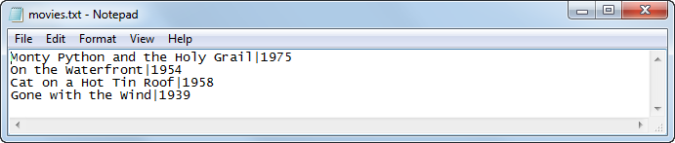
The data in the text file after one record has been added to it

Slide 35
The code

Slide 36
The user interface for the Word Counter program

Slide 37
The code

Slide 38
The code (cont.)

Slide 39
The user interface for the Hangman game

Slide 40
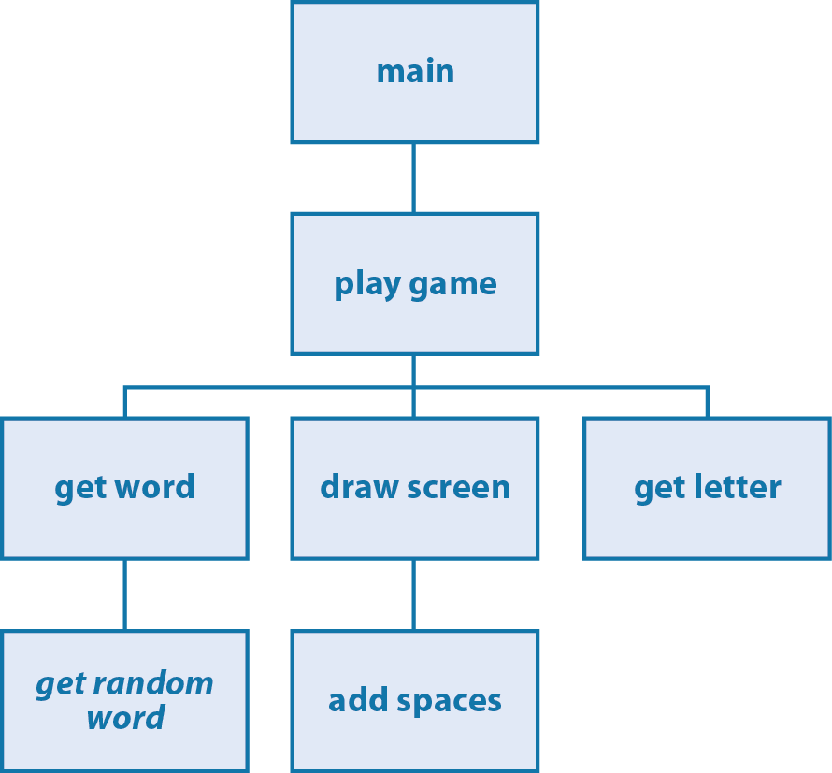
The hierarchy chart for the Hangman game

Slide 41
The wordlist module

Slide 42
The hangman module

Slide 43
The hangman module (cont.)

Slide 44
The hangman module (cont.)

Slide 45
The hangman module (cont.)

Slide 46
The hangman module (cont.)

